Slide 1
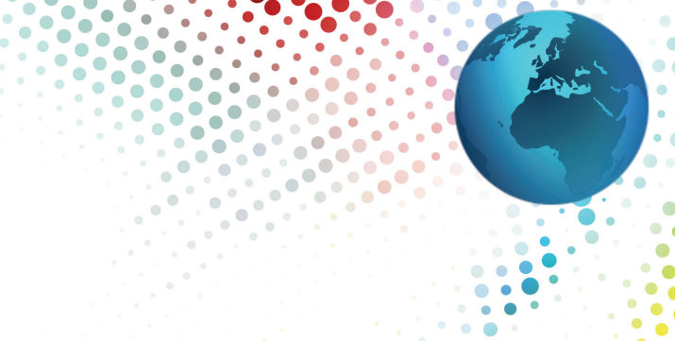
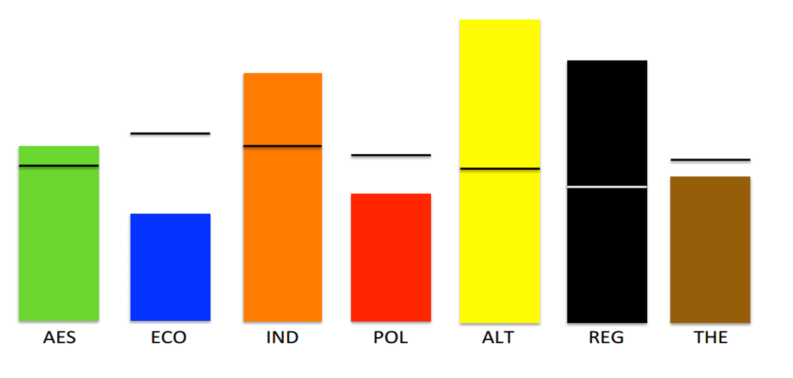
The Seven Dimensions of Motivation
Notes:
Motivators help people to better understand their unique value hierarchy or belief system pertaining to what motivates them, what they are most drawn to and where their passions lie.

Slide 2
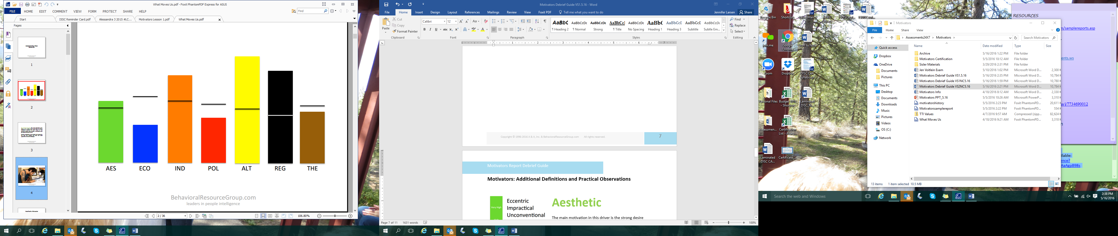
Motivators Benefits
Motivators
Help people to better understand their unique value hierarchy or belief system
Filter and guide decisions, specifically toward results that reflect them
Combine uniquely for each person to influence individual priorities and decision-making
Notes:
There are many benefits of learning what Motivators influence us.
The Motivators filter and guide decisions specifically toward results that will reflect them; they combine uniquely for each person to influence individual priorities and decision-making. It is vital for optimal performance that our motivations are satisfied by what we do.

Slide 3
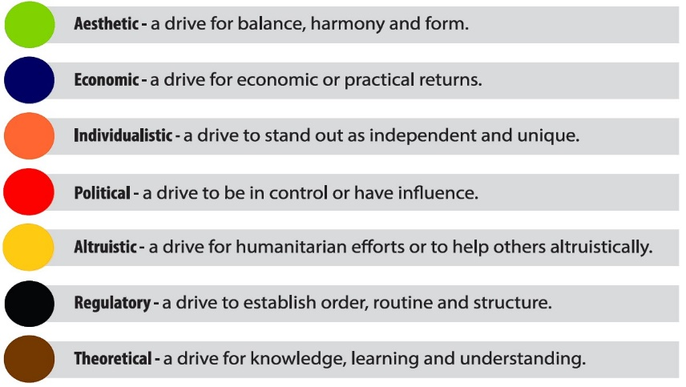
The Seven Dimensions of Motivation
Notes:
While it’s important to explore each motivator and what they mean, it is critical to remember that they cannot be separated. They can only be distinguished. Through an understanding of the motivators, we can begin to see how to maximize performance by achieving stronger alignment between our motivators, our choices, and our actions
The 7 Motivators:
Aesthetic - a drive for balance, harmony, and form
Economic - a drive for economic or practical returns
Individualistic - a drive to stand out as independent and unique
Political - a drive to be in control or have influence
Altruistic - a drive for humanitarian efforts or to help others selflessly
Regulatory - a drive to establish order, routine, and structure
Theoretical - a drive for knowledge, learning, and understanding

Slide 4
Scoring the Motivators
Both low and high scores can have an influence on the choices we make. Whether scores are high or low, the motivators with the furthest distance above or below the mean (or norm - the line in the center of the box plot) will be the highest influencers leading to the greatest impact on the decisions being made.
Average scores (in the mid-range noted by a grey box plot) create a normal degree of influence which is typically not noticeable.
Notes:
There are five score options for Motivators:
Very Low, Low, Average, High, Very High
Whether scores are high or low, the motivators with the furthest distance above or below the mean (or norm - the line in the center of the box plot) will be the highest influencers leading to the greatest impact on the decisions being made.

Slide 5
These descriptors are a result of the ongoing research of Steven Sisler and the Behavioral Resource Group.
Motivators Word Sketch
Impractical
Uncommon
Unconventional
Imaginative
Conservational
Sensible
Realistic
Practical
Hands-on
Grounded
Self-Interested
Maximized
Competitive
Incentivized
Practical
Fair
Relaxed
Aloof
Apathetic
Satisfied
Autonomous
Independent
Self-Reliant
Creative
Balanced
Cooperative
Accommodating
Supportive
Apprehensive
Subordinate
Domineering
Self-Important
Authoritative
Controlling
Directive
Controlled
Supportive
Yielding
Passive
Anonymous
Pushover
Sacrificial
Over-Accommodating
Obliging
Supportive
Helpful
Self-Protective
Suspicious
Distrusting
Unaffected
Black & White
Narrow-Minded
Systemic
Orderly
Disciplined
Open-Minded
Flexible
Independent
Disorderly
Defiant
Complicated
Cerebral
Rational
Analytical
Logical
reflective
Situational-Learner
Creative/Intuitive
Surface Analysis
Ill Considered
AES ECO IND POL ALT REG THE
Notes:
The word sketch provides descriptors of each dimension that align with the scoring. Using these “scales”, you can paint a holistic picture of an individual’s motivational drivers, and see what likely moves the person, or keeps them still as they make decisions that translate into action.

Slide 6
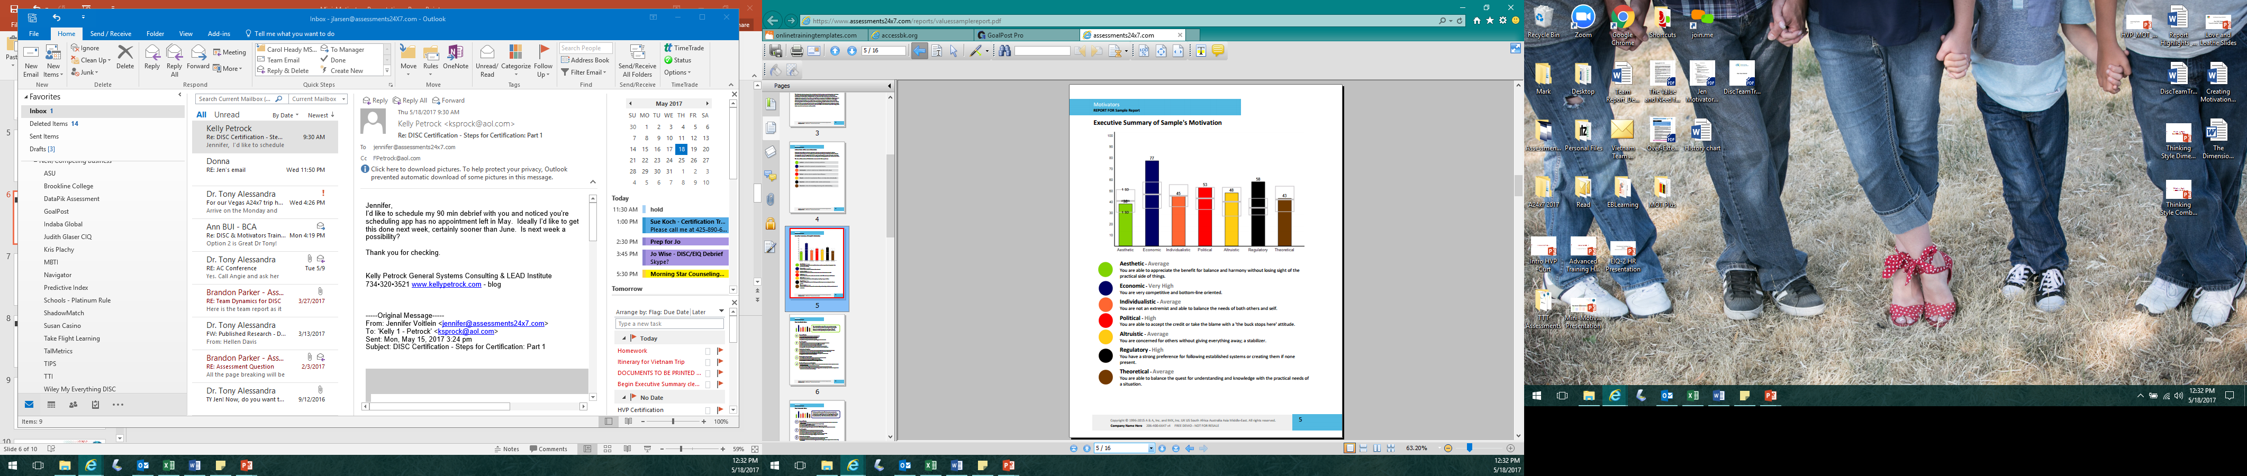
Motivational Summary
Insights for each motivator - an overview graph and user specific statement sets for further development
©2016 Assessments 24X7

Slide 7
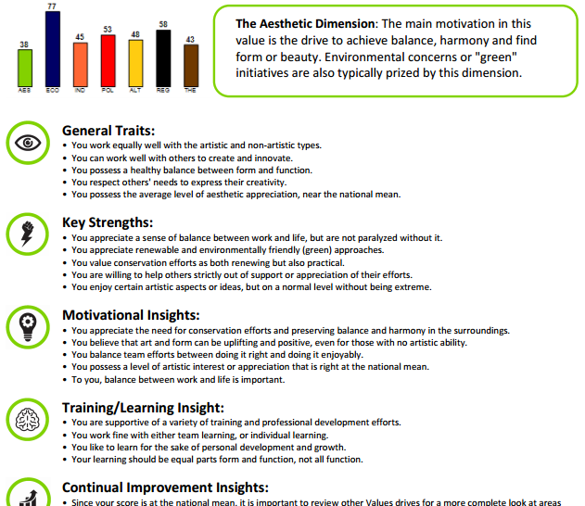
Individual Motivators Pages

Slide 8
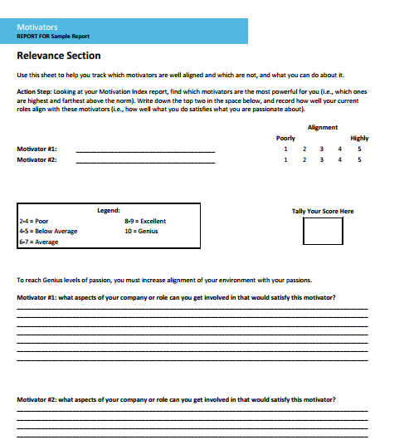
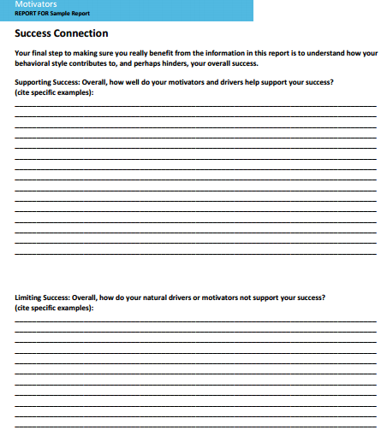
Application Activities

Slide 9
Coaching Opportunities
Use open-ended and purposeful follow-up questions to uncover opportunities and reveal areas support is needed. Discuss:
What are the primary motivators for this person?
How do those show up? What behaviors link to those drivers?
What awareness do they have about their individual scores?
Are those scores accurate and reflective of their mindset?
How do those motivators and that mindset influence their choices and behaviors?
Are their behaviors reflecting their wants accurately? If not, why not and should something be done to align them closer?

